Slide 1
Chapter 4.1: File System
What is a file system
Objectives and user requirements
Characteristics of files and directories
File system implementation
Directory implementation
Free block management
File system reliability
Increasing file system performance

Slide 2
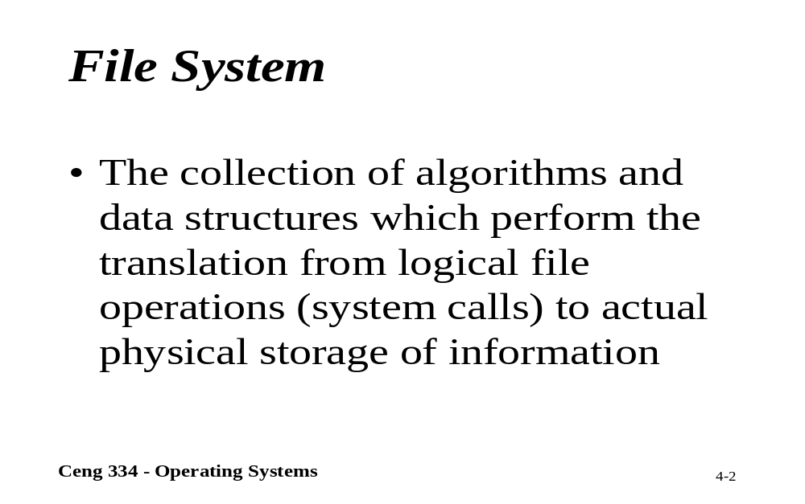
File System

Slide 3
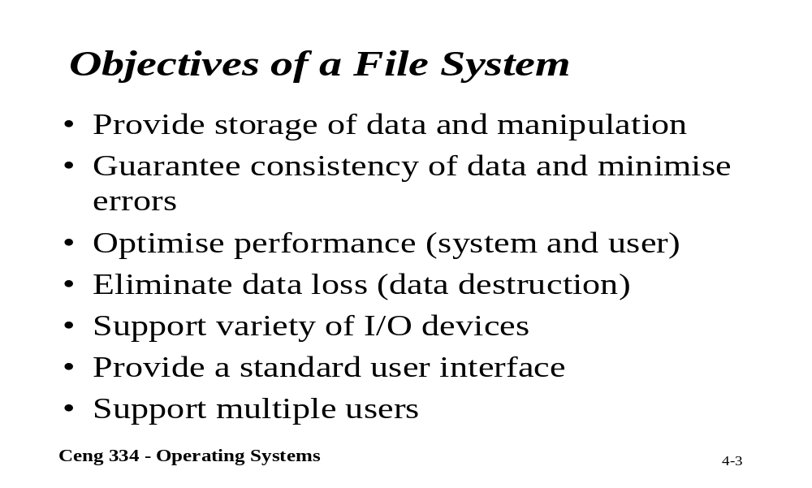
Objectives of a File System

Slide 4
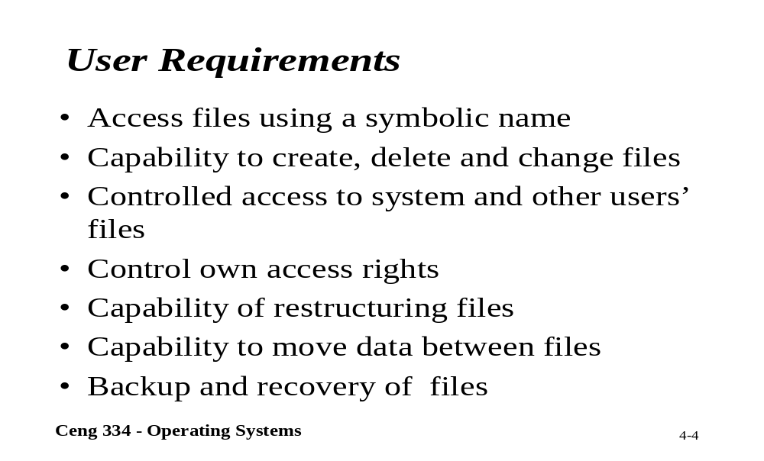
User Requirements

Slide 5
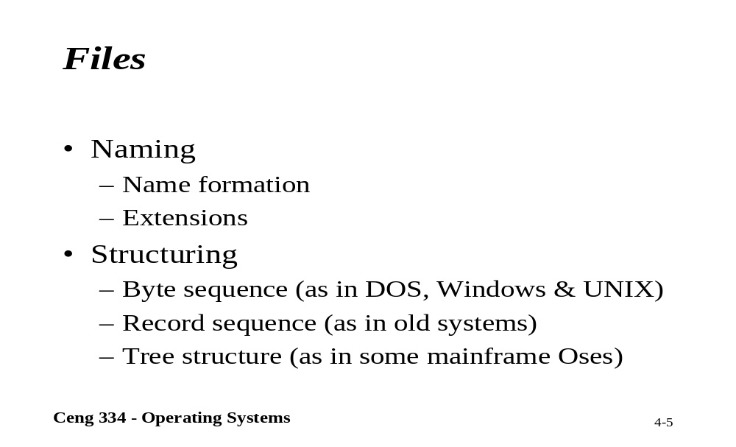
Files

Slide 6
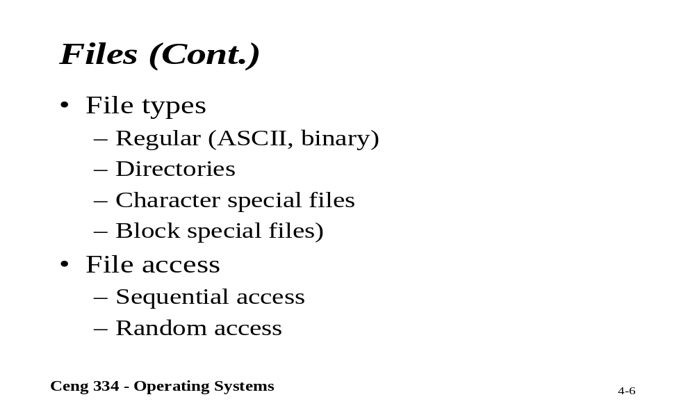
Files

Slide 7
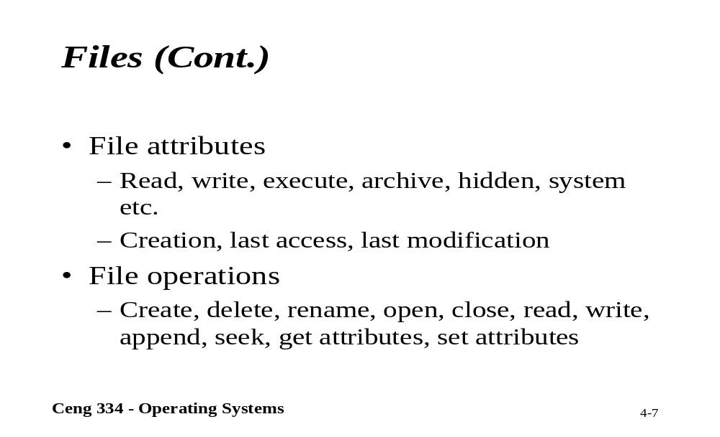
Files

Slide 8
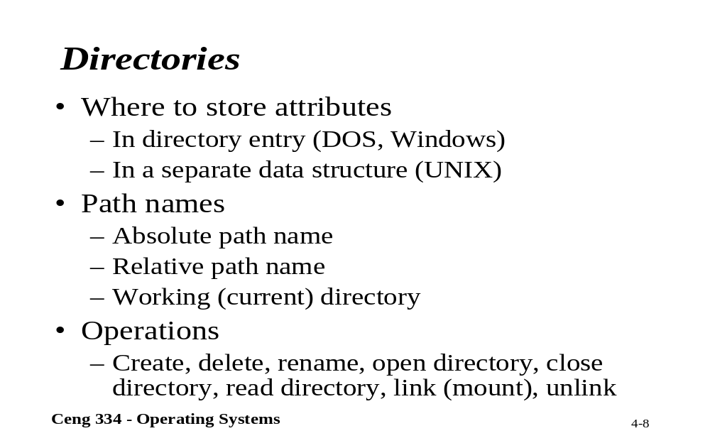
Directories

Slide 9
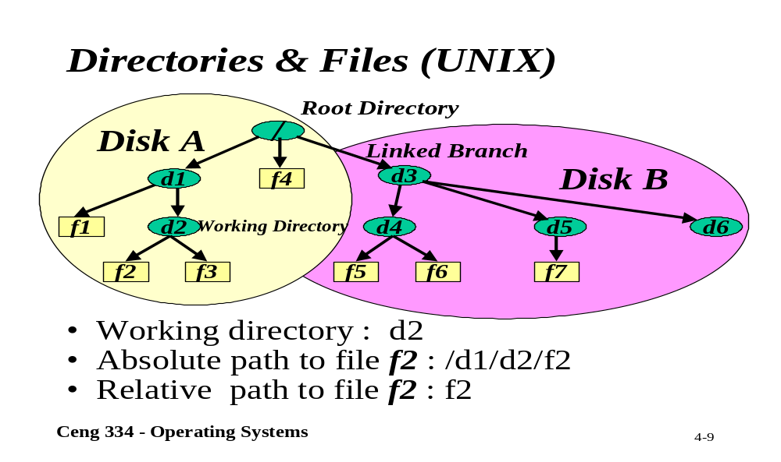
Unix; Directory and Files

Slide 10
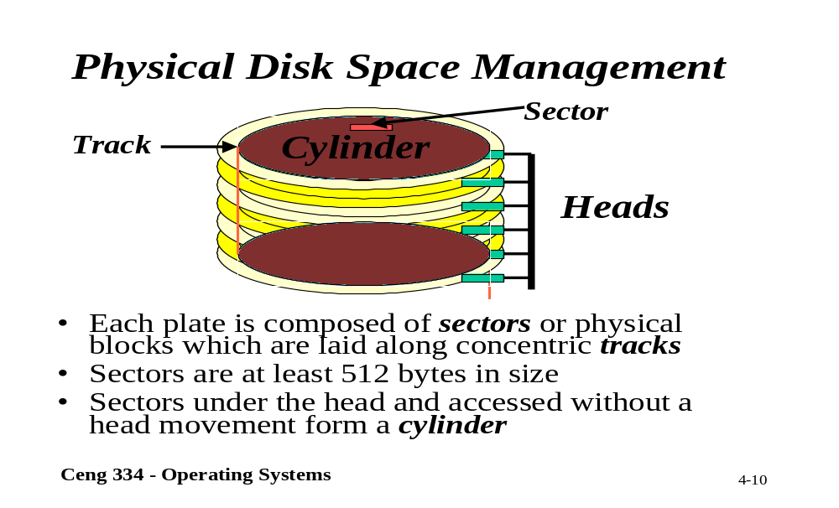
Physical Disk Space Management

Slide 11
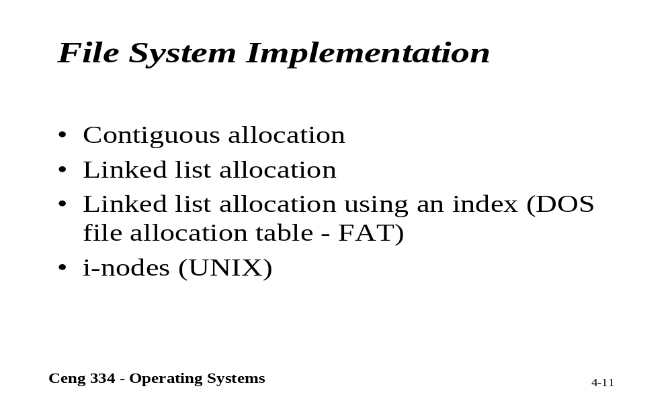
File System Implementation

Slide 12
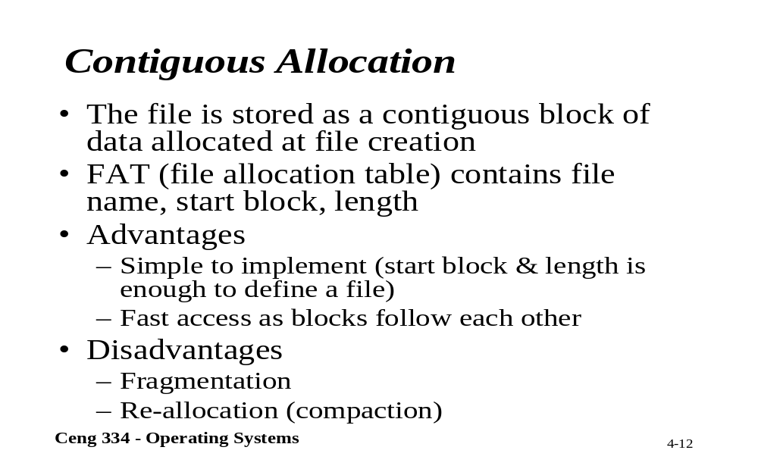
Contiguous Allocation

Slide 13
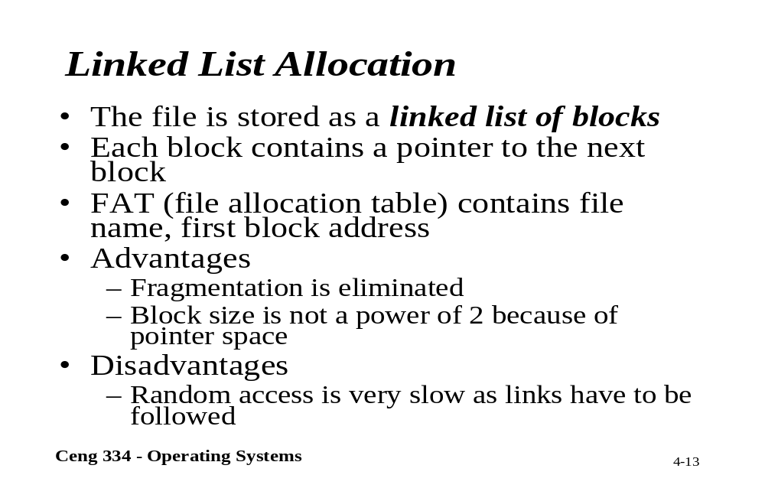
Linked List Allocation

Slide 14
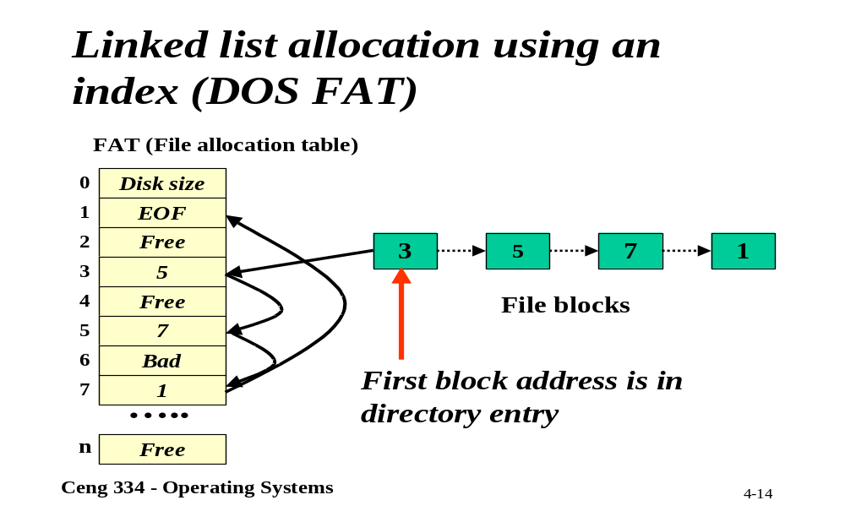
Linked List (DOS FAT)

Slide 15
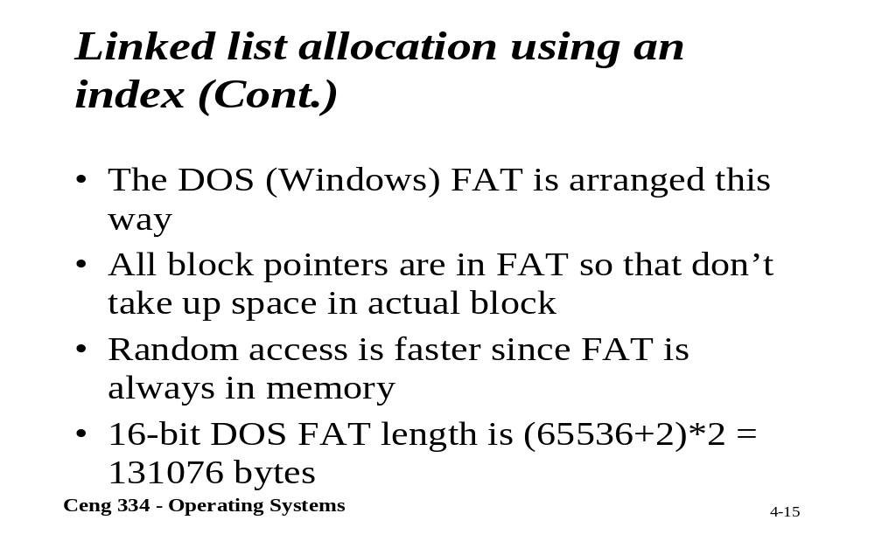
Linked List Using an Index

Slide 16
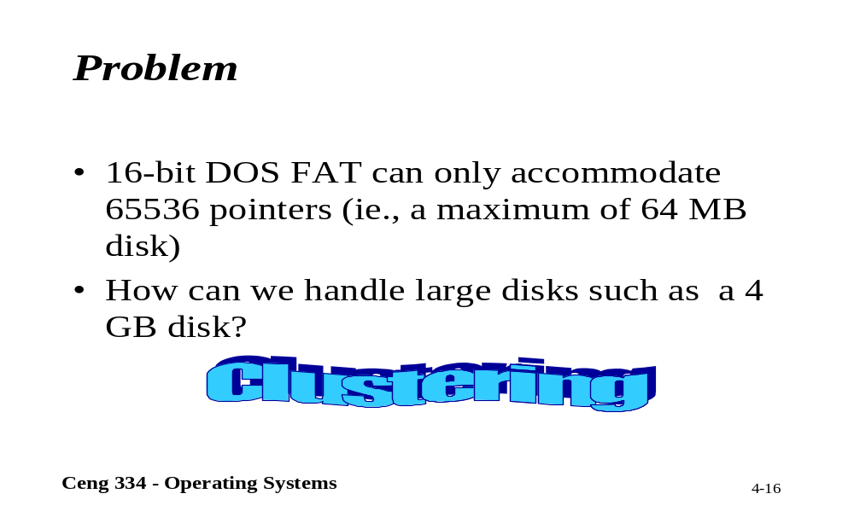
Problems

Slide 17
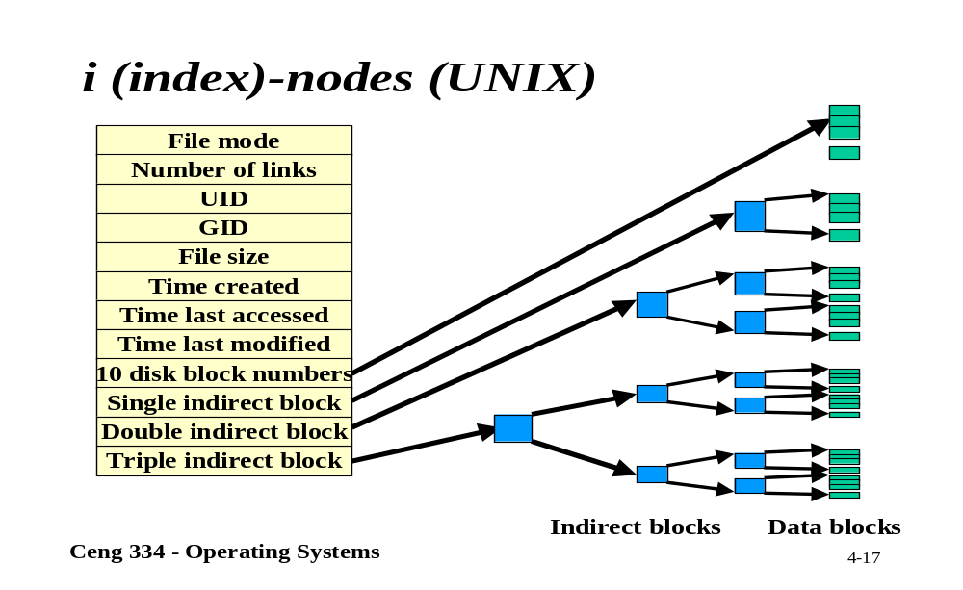
Unix; i-nodes

Slide 18
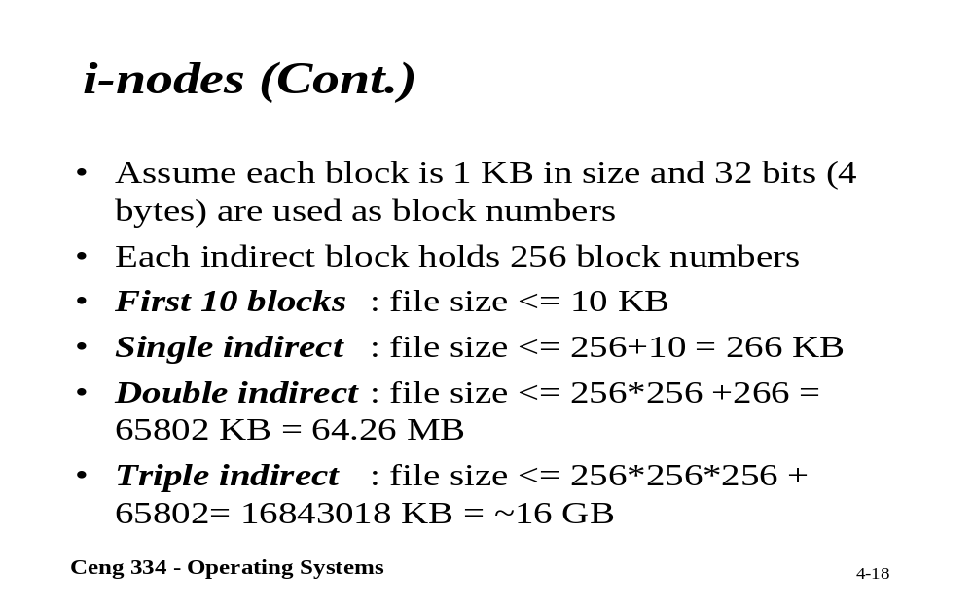
i-nodes

Slide 19
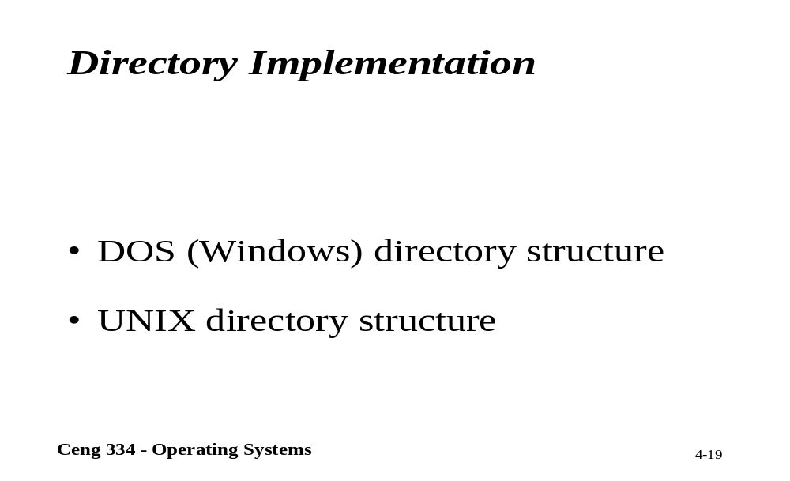
Directory Implementation

Slide 20
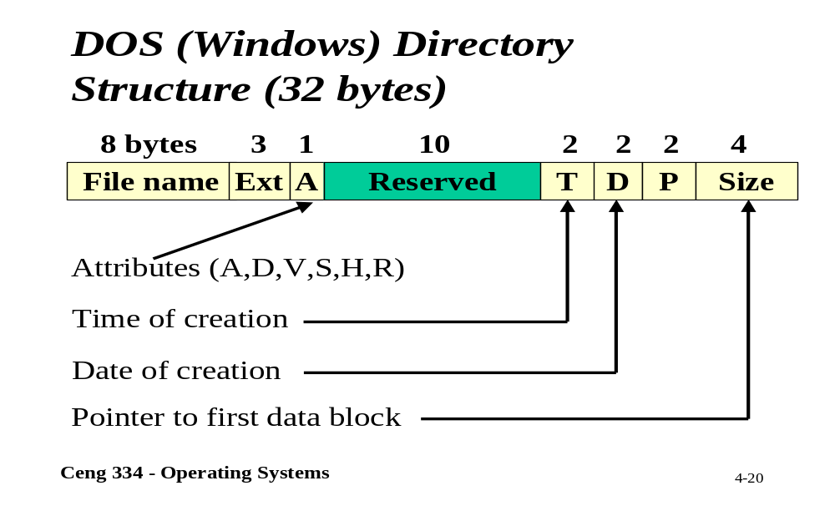
DOS; Directory Structure

Slide 21
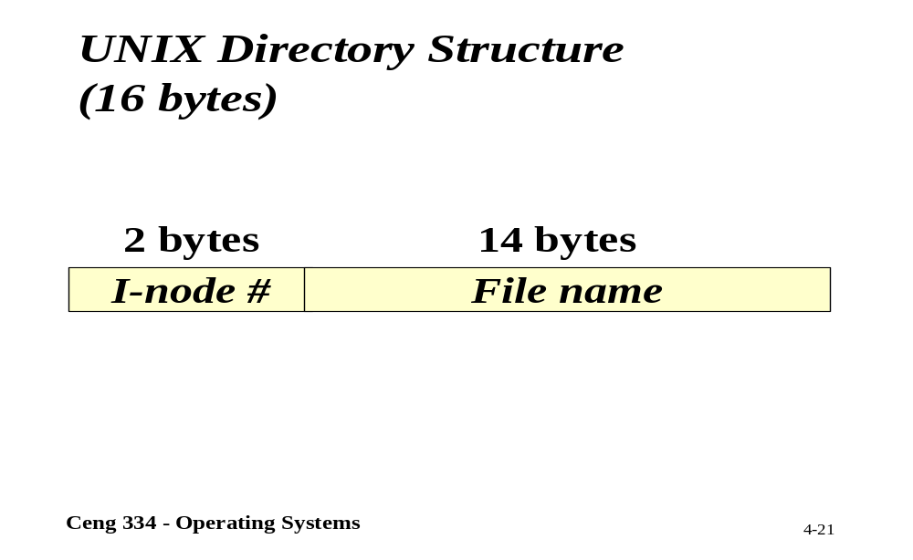
Unix; Directory Structure

Slide 22
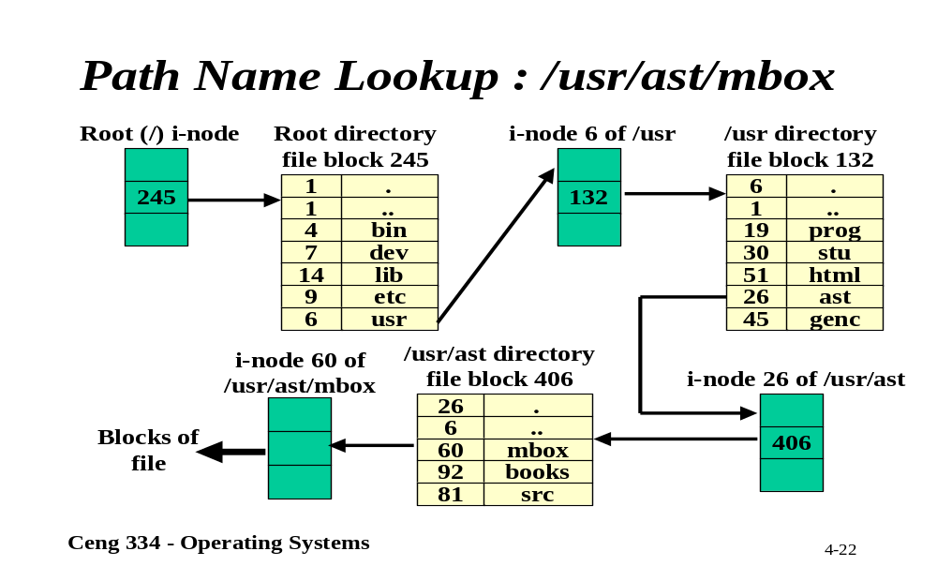
Path Name Lookup

Slide 23
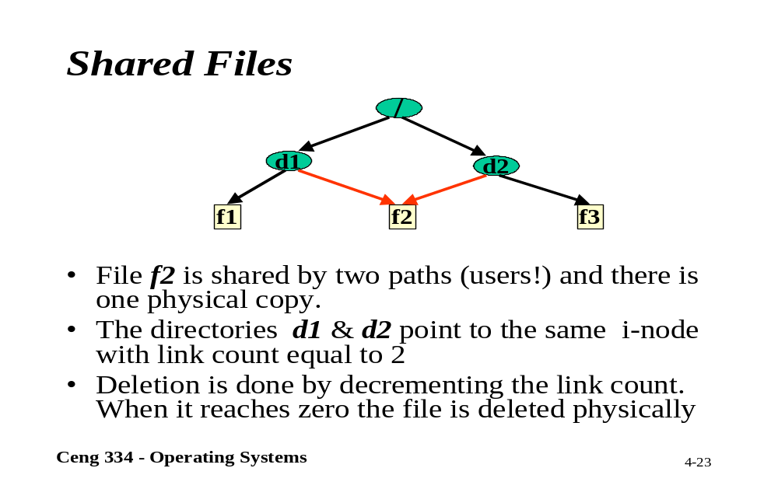
Shared Files

Slide 24
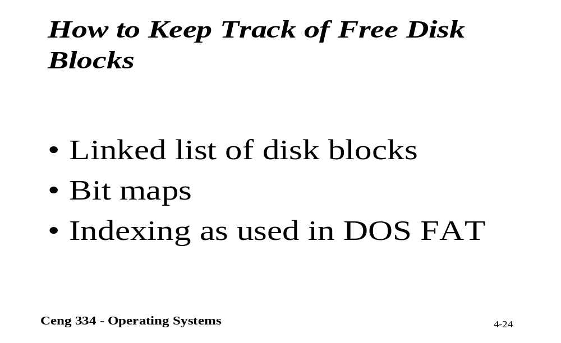
Keeping Track of Disk Blocks

Slide 25
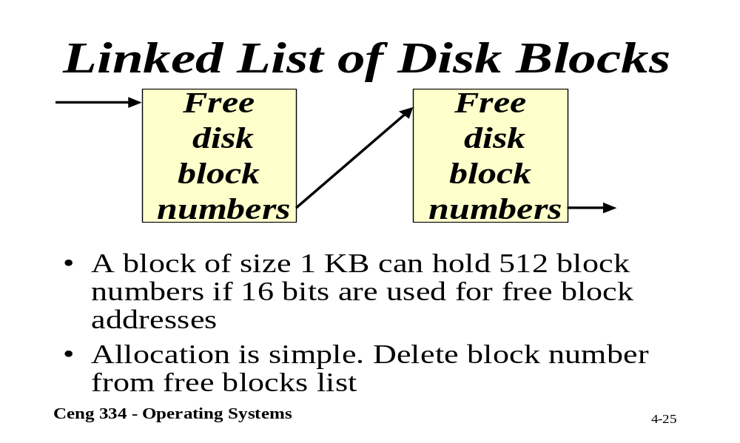
Linked List of Disk Blocks

Slide 26
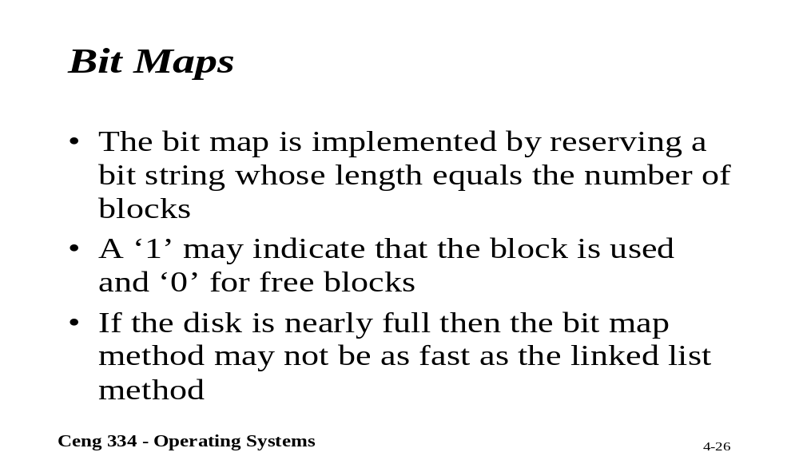
Bit Maps

Slide 27
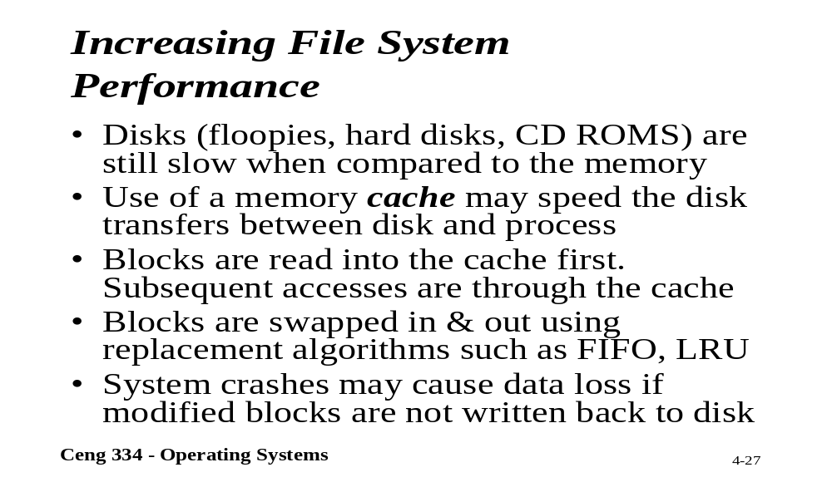
File System Performance

Slide 28
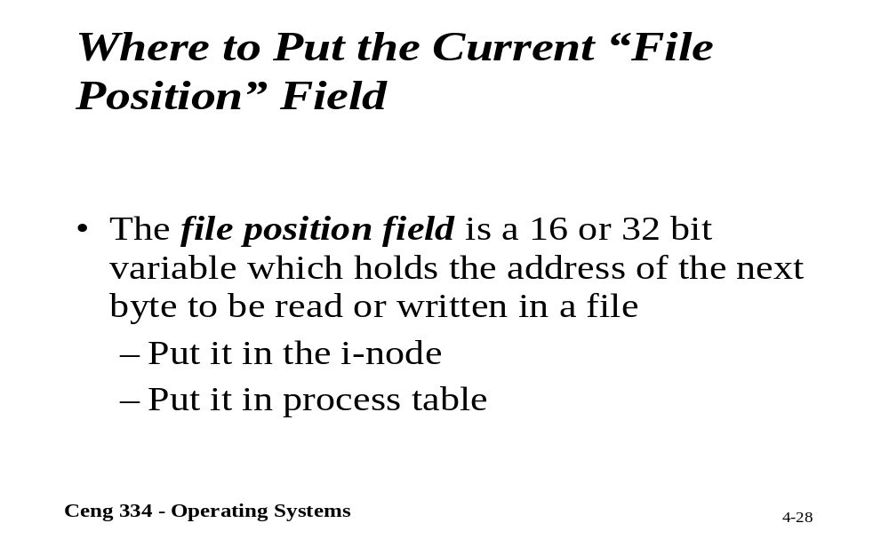
File Position

Slide 29
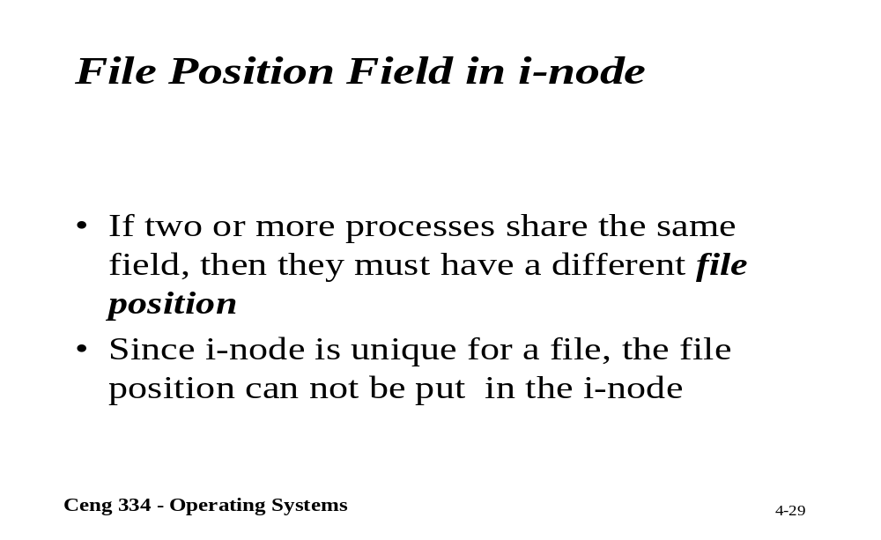
File Position in i-node

Slide 30
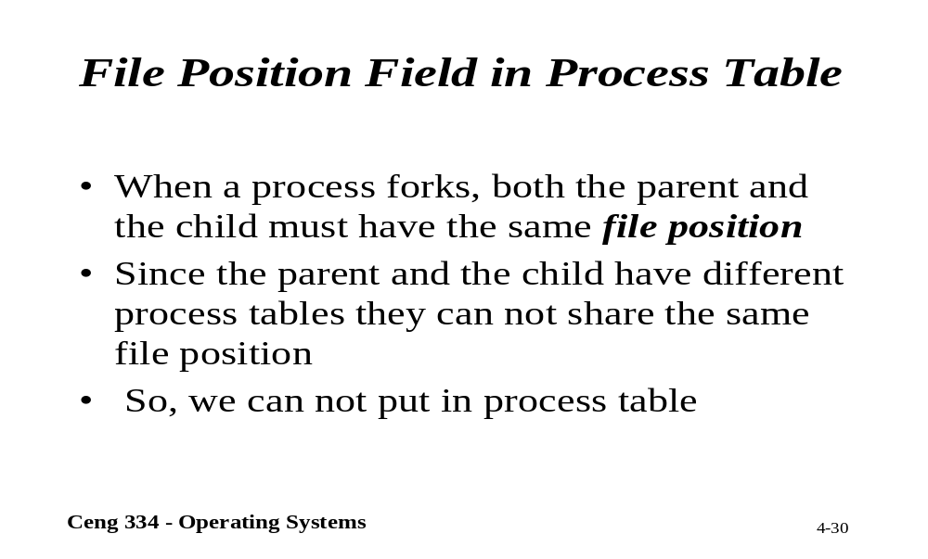
File Position in Process Table

Slide 31
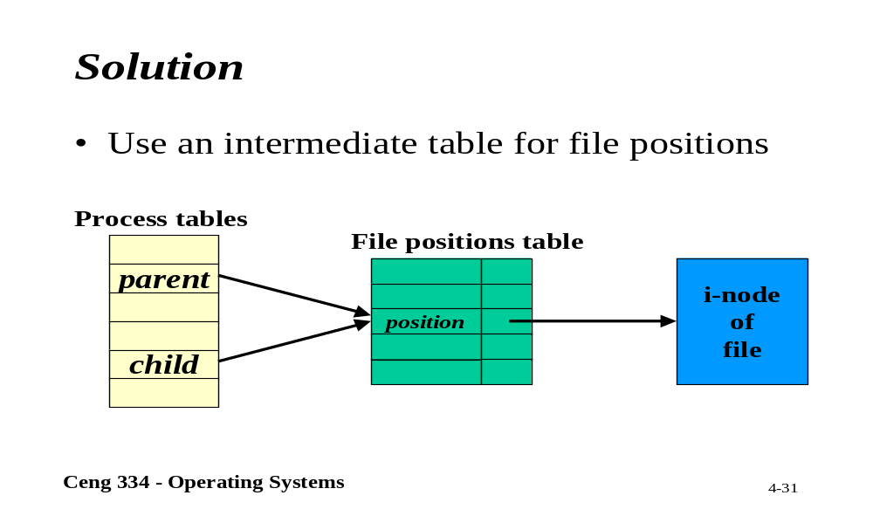
Solution

